Slide 1
一起学
Notes:
Black slide left for drafting conclusion

Slide 2
Learn SQL+R from beginning to expert
Expert
Skill
2 hours?
New
Time
Notes:
Black slide left for drafting conclusion

Slide 3
Programming: learn SQL + R/Python
/
Language to query from databases
SQL like thinking is critical in programming
Very good statistics packages
Very good visualization packages
Dplyr!!
Accepted by CS
Closest language to C++/Java
Decent amount of packages
Notes:
Black slide left for drafting conclusion

Slide 4

Goal of a good programmer:
指哪打哪
It is fine to Google
You need to write short code
Code as you think
Notes:
Black slide left for drafting conclusion

Slide 5
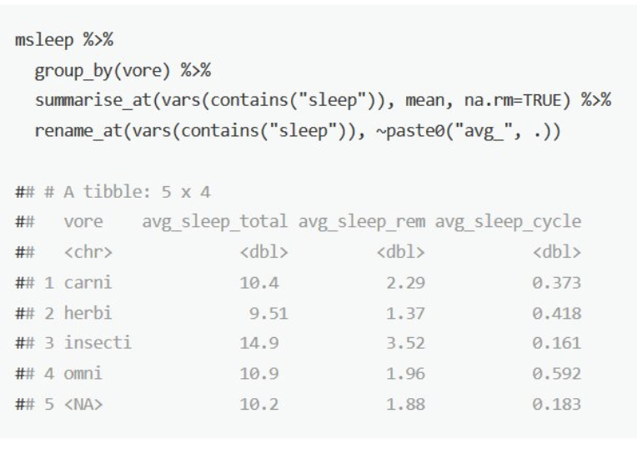
Key areas planed to cover in R
Basic syntax
How to write all codes with data frame (dplyr)
Best tool for visualization (ggplot2)
How to avoid for loop
How to validate
Notes:
Black slide left for drafting conclusion

Slide 6
What to expect today
R basics
dplyr
ggplot
reshape
QUIZ
dplyr and SQL
Coding speed
Demo and practice

Slide 7
箴11:14 “无智谋，民就败落；谋士多；人便安居。”
箴12:15 “愚妄人所行的，在自己眼中看为正直；惟智慧人肯听人的劝教。”
箴13:10 “骄傲只启争竞；听劝言的，却有智慧。”
箴15:22 “不先商议，所谋无效；谋士众多，所谋乃成。”
箴19:20 “你要听劝教，受训诲，使你终久有智慧。”
箴20:18 “计谋都凭筹算立定；打仗要凭智谋。”
箴27:9 “膏油与香料使人心喜悦；朋友诚实的劝教，也是如此甘美。”
Notes:
Black slide left for drafting conclusion

Slide 8
Coding in data science is different than software engineer
Easy to read
One function
Short
Easy to scale
Multiple functions
Long
Coding in data science
Software engineer
Notes:
Black slide left for drafting conclusion

Slide 9
R basics

Slide 10
Data types in R
Logical: TRUE, FALSE (T, F)
Numeric: v <- 23.5
Character: v <- "TRUE"
Vector: apple <- c('red','green',"yellow")
Factors: factor(c('green','green','yellow','red','red','red','green’))
Data frame: BMI <- data.frame( gender = c("Male", "Male","Female"), height = c(152, 171.5, 165), weight = c(81,93, 78), Age = c(42,38,26) )
List, matrices, arrays
Notes:
Black slide left for drafting conclusion

Slide 11
Variables
Naming convention: only special character dot (.) is allowed in R
List all variables: print(ls())
Remove variables: rm(df), rm(list=ls())
Notes:
Black slide left for drafting conclusion

Slide 12
Assign
<-: v <- 3.5
>-: 3.5 >- v

Slide 13
Operations
+ - * /
%% remainder
%/% quotient
^: power
>, <, ==, <=, >=, !=
&, |, !
Notes:
Black slide left for drafting conclusion

Slide 14
Decision making in R
If else:
x <- 30L if(is.integer(x)) { print("X is an Integer") }
Notes:
Black slide left for drafting conclusion

Slide 15
Loops
for (value in vector) { statements }
while (test_expression) { statement }
Notes:
Black slide left for drafting conclusion

Slide 16
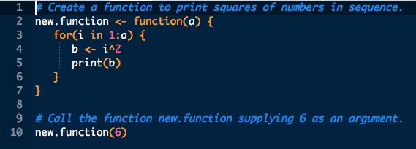
Functions
source(file_directory)
Notes:
Black slide left for drafting conclusion

Slide 17
dplyr

Slide 18
Matrix (data frame) thinking is the most important
Notes:
Black slide left for drafting conclusion

Slide 19
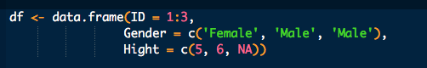
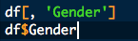
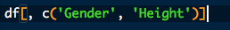
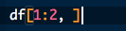
Data frame
ID | Gender | Height
1 | Female | 5
2 | Male | 6
3 | Male | NA
Create a data frame
Extract one column (vector)
Extract two columns (data frame)
Extract first two rows as a data frame
Column names as a vector

Slide 20
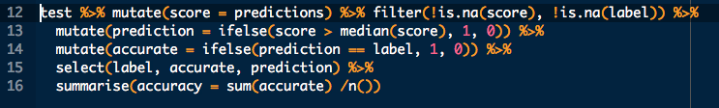
dplyr is the perfect tool to match the speed of your thinking process
Pipeline operator %>%: pass the outcome before it as the first input parameter of the function after it
Notes:
Black slide left for drafting conclusion

Slide 21
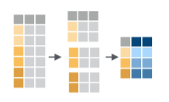
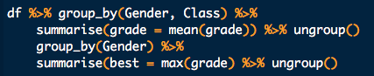
Dplyr group_by %>% summrise group_by %>% mutate
group_by(c1) %>% summarise(avg=mean(c1), max = max(c1))
group_by(c1) %>% mutate(avg=mean(c1))
Multiple group_bys

Slide 22
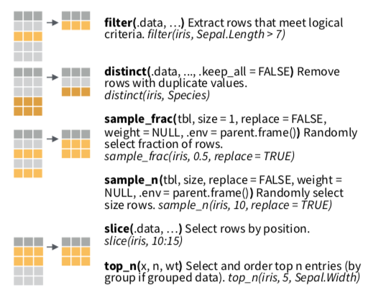
dplyr (select by rows)

Slide 23
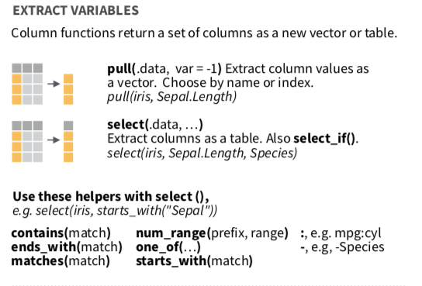
dplyr (select by columns)

Slide 24
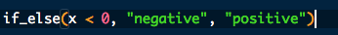
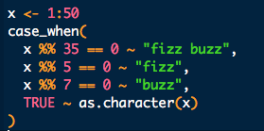
dplyr if_else case_when

Slide 25
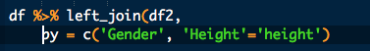
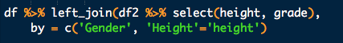
dplyr left_join inner_join
Only use left_join to simplify your thinking process
Think before you join
Make sure check the uniqueness of the right table
Validate the number of rows after each join

Slide 26
Questions
What’s the operation to collapse the matrix to a single number?
In df <- data.frame(height = x), is x a vector or a data frame?
What does this return df$height, a vector or a data frame?
What does this return df %>% select(height), a vector or a data frame?
How to return a vector in dplyr?
If you want to add a column to a data frame without changing the number of rows, what operator(s) should you choose?
If you want to add a column to a data frame that’s based on groups of some variables, what operation(s) should you choose?
If you want to create a new column which is based on a binary condition, what operation(s) should you use?
If you want to select the 2 highest female and 2 highest male, what operations should you use?

Slide 27
Additional questions
How to check if there are duplicates of two columns of a data frame? How to clean it before joining if there are?
How to check the unique values of one column? Can you name two approaches?
How to check the column names of a data frame? Name two approaches.
Can you name three approaches to return the number of rows of a data frame?

Slide 28
library(reshape2)
analysis Reshape2 conflicts with dplyr!! (run detach("package:reshape2", unload=TRUE) after using reshape2)
always prefers long format, shift to wide format when needed
Name | Week | Distance
Coco | 1 | 5
Coco | 2 | 6
Coco | 3 | 4
Coco | 4 | 5
Yang | 1 | 1
Yang | 2 | 2
Yang | 3 | 1
Yang | 4 | 0
Name | Distance_Week1 | Distance_Week2 | Distance_Week3 | Distance_Week4
Coco | 5 | 6 | 4 | 5
Yang | 1 | 2 | 1 | 0
Wide format
Long format
Notes:
Black slide left for drafting conclusion

Slide 29
library(ggplot2)

Slide 30
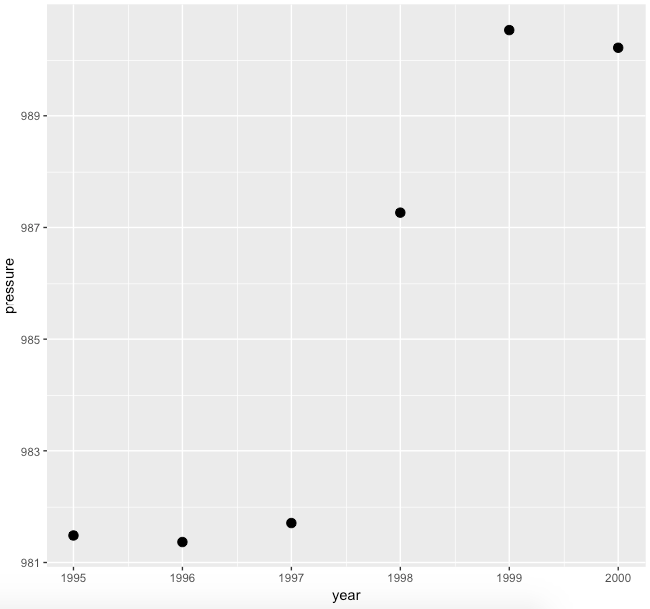
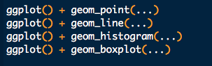
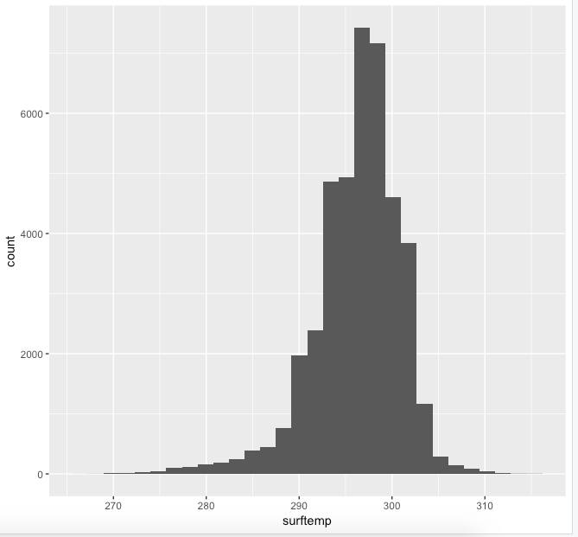
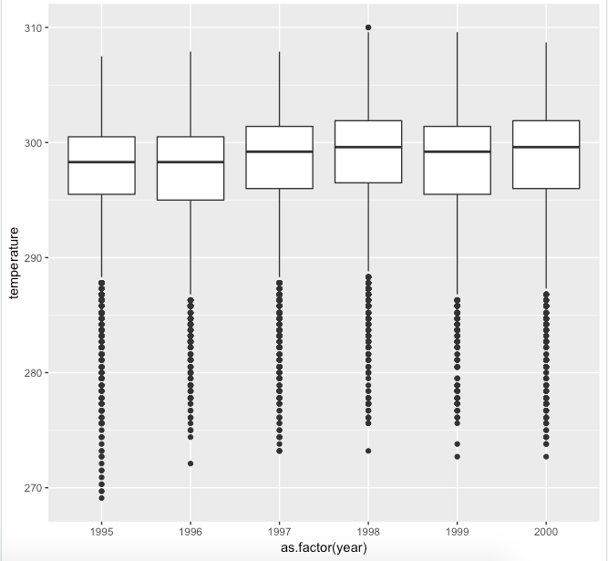
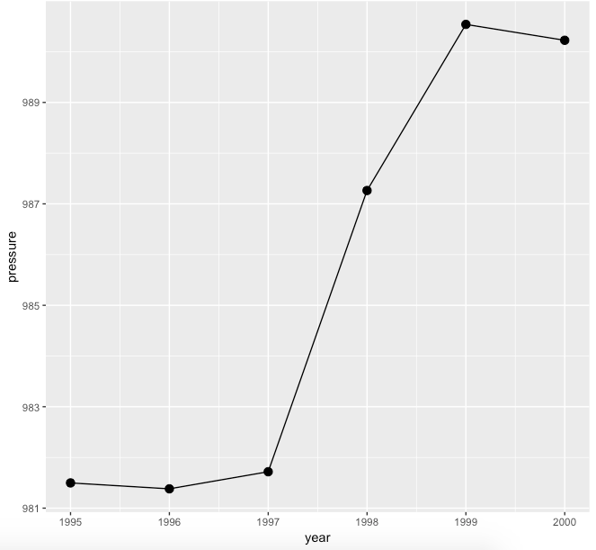
Four plotting functions
Notes:
Black slide left for drafting conclusion

Slide 31
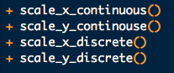
Two/four labeling functions
Typical variables inside the functions
name = “Height”
limits = c(5, 8)
breaks = …
labels = …
Notes:
Black slide left for drafting conclusion

Slide 32
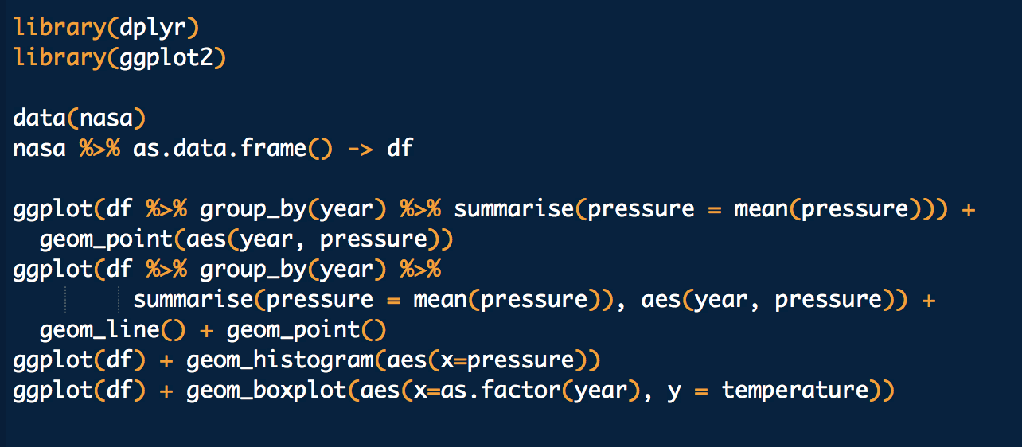
Examples

Slide 33
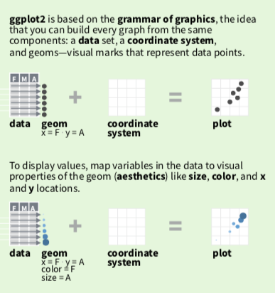
ggplot2
To use data frame variables in the plot, wrap variables with aes(). Exmaple aes(x = height, y = weight)
For any other static variable, put it outside aes. Example: ggplot(df) + geom_point(aes(x=height, y=weight), color =‘red’)
If df, aes() are put in ggplot() then they are shared for all later on functions
If df, aes() are put in specific plot (like geom_point()) then it only applies to that specific function

Slide 34
A few important rules
Almost no for loop (if there is for loop, minimize it to be less than 100 total runs)
No magic number
Code should be run in seconds (if not, remove for loop; analyze where the code is slow; downsample the data)
Validate number of rows after every dplyr operation
Use left_join only
Save data in the long format as much as possible
Notes:
Black slide left for drafting conclusion

Slide 35
SQL

Slide 36
SQL is about selecting data from database tables
select *
from table_name;

Slide 37
One chart to understand SQL from dplyr
dplyr | SQL
select(c1, c2) | select c1, c2
filter(c1 == 3, c2 > 4) | where c1 = 3 and c2 > 4
arrange(c1) | order by c1
left_join(df2, by = c('c1' = 'c2', 'c3' = 'c4', ...)) | left join df2 on df.c1 = df2.c2 and df.c3 = df2.c4
group_by(c1, c2, c3) + summarise(c4 = …) | select c1, c2, c3, ... as c4 group by c1, c2, c3
group_by(c1, c2, c3) + mutate(c4=...) | select c4=… over (partition by c1, c2, c3)
n() | count(*)
The main difference is syntax
SQL has very specific orders
Many group_by summarise lef_join will result in a very long and nested code in SQL
Notes:
Black slide left for drafting conclusion

Slide 38
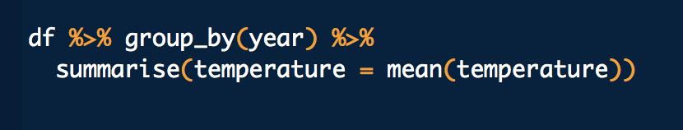
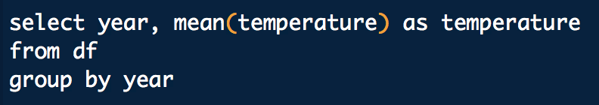
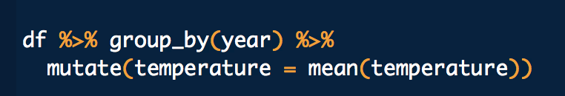
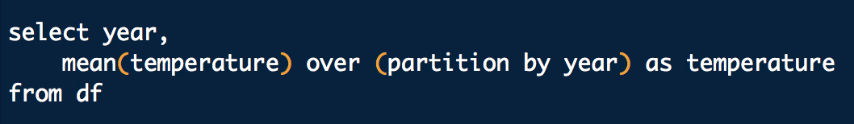
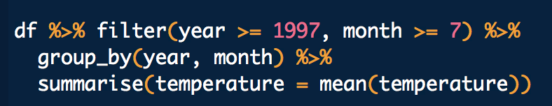
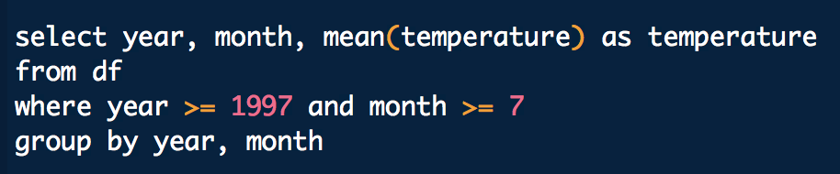
Examples
dplyr
SQL

Slide 39
Coding speed

Slide 40


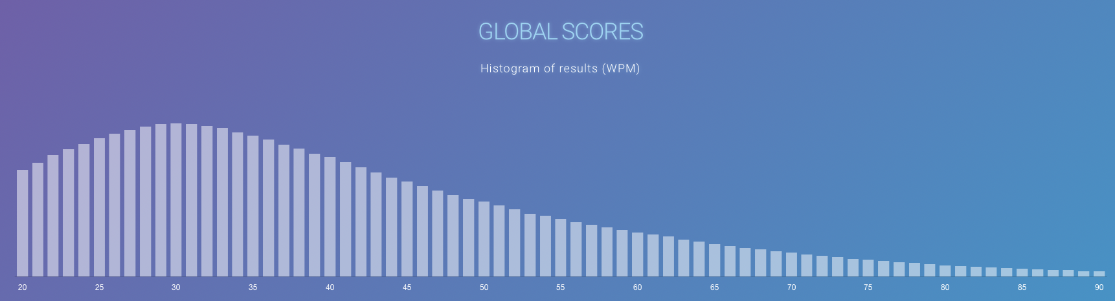
Are you an Octopus?

Slide 41
Important shortcuts to improve your coding speed
Move cursor by one word: option + left/right arrow
Move cursor to the beginning or end of a line: Command + left/right arrow
Select one word: shift + option + left/right arrow
Select one line: shift + command + left/right arrow
Select multiple lines: shift + command + up/down arrow

Slide 42
Learn coding shortcuts
TAB
Parenthesis
Quote

Slide 43
Browser and switching between browser and RStudio
Switch: command + tab
Next tab: command + shift + ]
Previous tab: command + shift + [

Slide 44
Demo

Slide 45
Checklist
Assign variables (logical, numeric, character, vector)
Operations (+ - * /, ^)
If () {} else {}
Loops (while loop, for loop)
Create a function
Data frame – create a data frame, extract one to many columns, extract a column as a vector, extract first few rows and few rows by group
Data frame – group by & summarise, group by & mutate
Data frame – left join
Data frame – create a new column from a vector, rename a column, create a column as a constant, create a column using if else, create a column using case_when
Data frame – arrange
Data frame – read.csv, write.csv
Reshape (check the help)
ggplot – aes
ggplot – geom_point, geom_histogram, geom_boxplot, geom_line
Ggplot – scale_x_continuous, scale_x_discrete, scale_y_continuous, scale_y_discrete

Slide 46
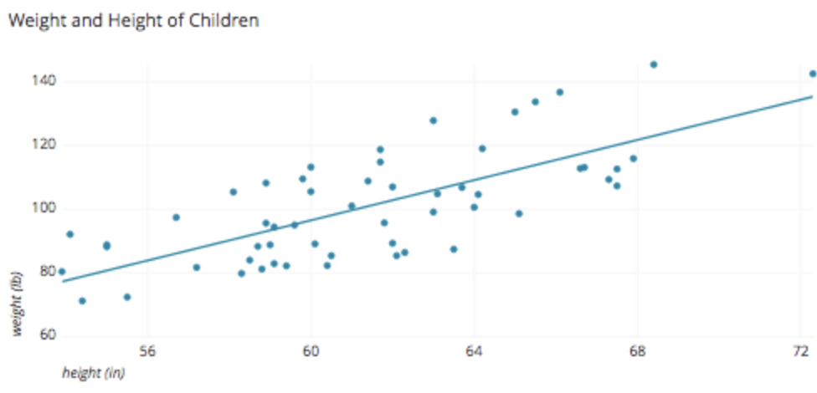
Next time - key modeling techniques
Operations Research
Basics
Machine learning (regression, tree based, neural network)
Variance decomposition
Notes:
Black slide left for drafting conclusion

Slide 47
Planning for this course
R basics
Machine Learning basics
dplyr
visualization
Regression
Tree
Neural network
First project (easy)
Get familiar with R
Get familiar with basic modeling techniques
Analytical presentations
Assertion Evidence based presentation
Leverage AE to drive your data science
Work in a data science team
Analytical planning
QA/AC
How to prepare for a meeting
How to work with a data science manager
How to improve yourself in the team
Pathway to be a data science lead
Analytical goals and steps
Value driven
Statistics basics, Operations Research basics
Second project (medium or hard)
Kaggle projects
Natural language processing - dictate Mingqi's sermons
Other projects
Notes:
Black slide left for drafting conclusion

Slide 48
Notes:
Black slide left for drafting conclusion

